Slide 1
Improving Herd Performance Through Genetics! 通过基因改善牛群性能
Jeff Ziegler – 40 years at Select Sires
Vice President Dairy Cattle Breeding
杰夫 齐格勒—40年在Select Sires的工作经历
奶牛育种副总裁
jhzieg@selectsires.com

Slide 2
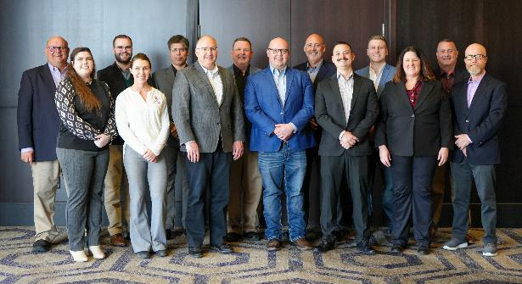
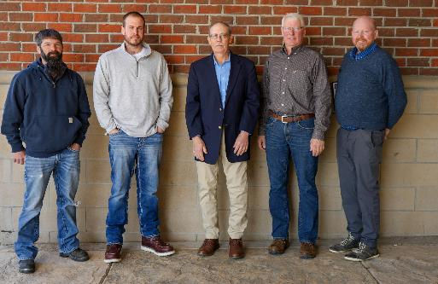
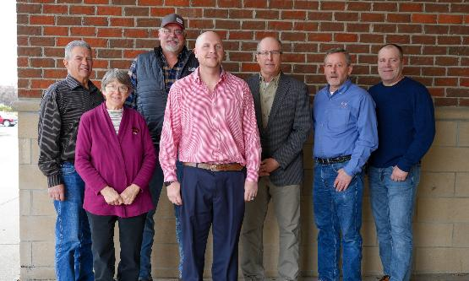
Meet the GENETIC Team 基因团队成员
Sire Development Team
公牛开发团队
Sire Committee
公牛委员会
Farmer Owned Board
牧场主组成的董事会

Slide 3
Genetic Improvement Formula
基因改良公式
Professor Jay Lush - 1942
Accuracy精确度 x Selection Intensity 选择强度x Genetic Variation 遗传变异
_________________________________________
Generation Interval
世代间隔
Pre-Genomics
60 months
基因组学前
60个月
Post-Genomics
18 months
基因组学后
18个月

Slide 4
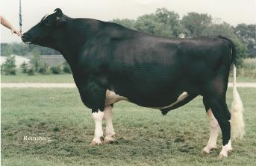
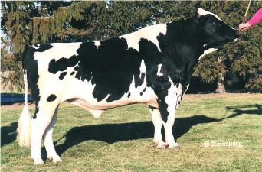
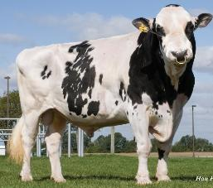
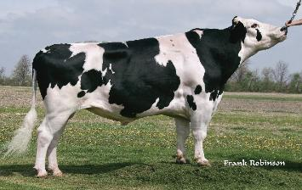
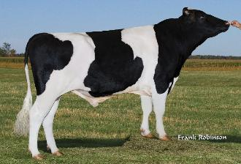
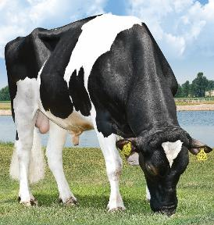
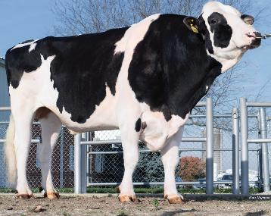
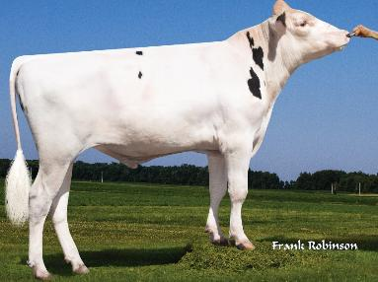
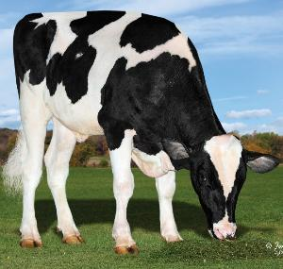
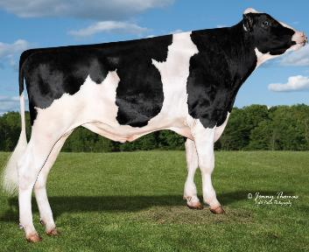
CHAIRMAN
BLACKSTAR
EMORY
BLITZ
SOCRATES
ROBUST
32 Years 1 Month
32年零1个月
6 Generations
6代公牛
Pre –Genomics
前基因组学
Genomics
基因组学
6 Generations
6代公牛
10 Years 1 Month
10年零个月
SUPERSIRE
JOSUPER
FRAZZLED
BIG AL
GAMEDAY
BOLT ACTION
Notes:
In the pre-genomic era it would typically take until a bull was about five years old until he would have a daughter proof – meaning he had at least 10 daughters contributing performance data to his evaluation like milk production or a conformation score. It wasn’t until a bull had daughter data, that his semen would be used to create the next generation. This means we would bring bulls into stud like BLACKSTAR around 6 months to a year old, collect his initial semen and send it to herds enrolled in the PGA program for sampling, and then continue to feed him until his genetic value was confirmed with daughter data. Once he had daughter data we would either sell semen from the bull or cull him.
From CHAIRMAN to ROBUST it took a little over 32 years to create five generations of bulls. Compare that to the genomic young sires of today we created 6 generations in 10 years. The value - we can increase the genetic progress of our cattle population by introducing superior genetics at a much younger age. It also allows us to breed our lower ranked animals to beef and our most elite animals to sexed semen. It’s a win-win. Dairy farmers can sell beef calves for higher dollar figures than a regular dairy bull calf and improve their herd performance with elite genetics faster.

Slide 5
Why do Genetics Matter? 为什么基因学很重要？
We must feed a Growing Population
Dairy Products, a growing protein source
Sustainability is a MUST
我们必须给不断增长的人口提供乳制品，不断增长的蛋白质来源的
可持续发展是必须的

Slide 6
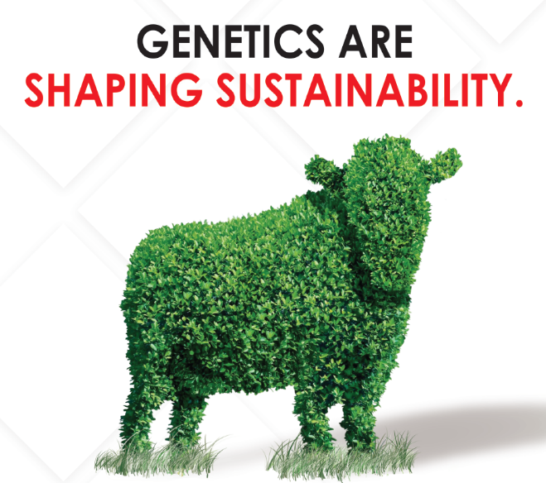
Global Outlook in 2050
2050年全球展望
392 Million Dairy Cows
+5%
3.92亿奶牛
增幅5%
9.38 Billion People
+28%
90.38亿人口
增幅28%
基因学正在
塑造可持续性
Source: D3.2 Annual Dairy Sector Data – with IFCN Long-term Dairy Outlook based on Pro dairy scenario; published 3/2020
Notes:
9% of the cow population lives in the United States.
What do you notice about the average milk production?
Where is the opportunity for growth?
Why do Genetics Matter?
WE need to feed a growing population and improve or global efficiencies.

Slide 7
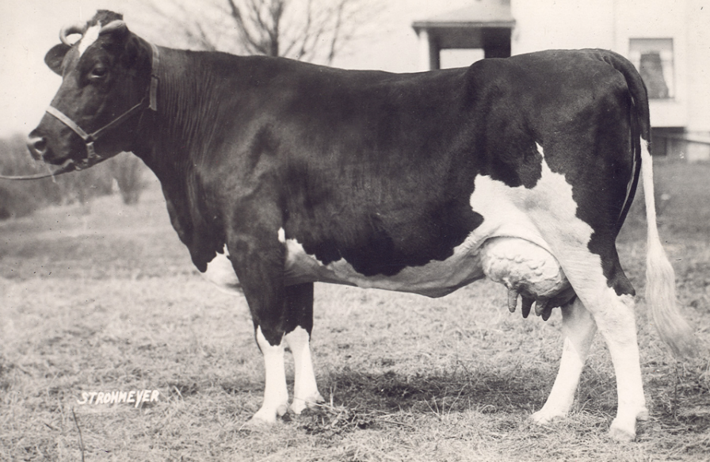
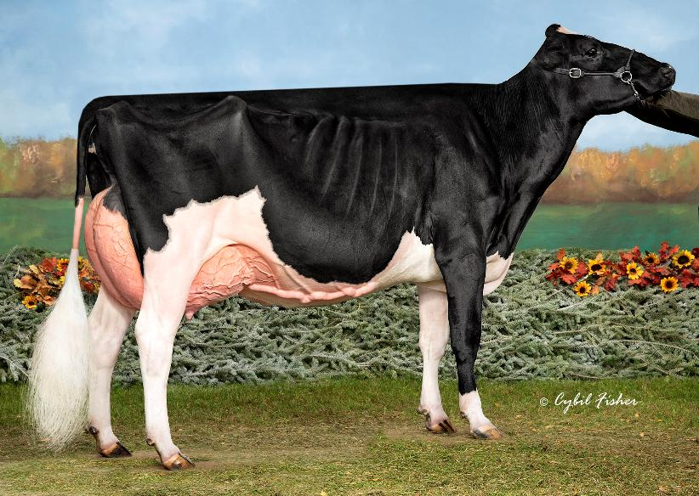
Improved Efficiency
效率提升
1930’s
21st Century 21世纪
1,497 liters of Milk
1497升牛奶
11,606 liters of Milk
11606升牛奶

Slide 8
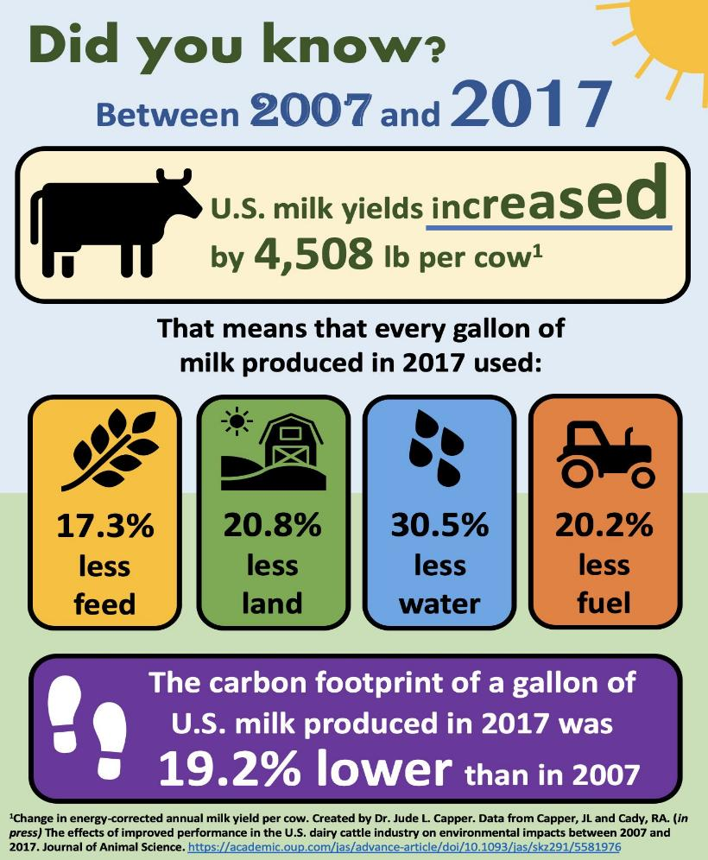
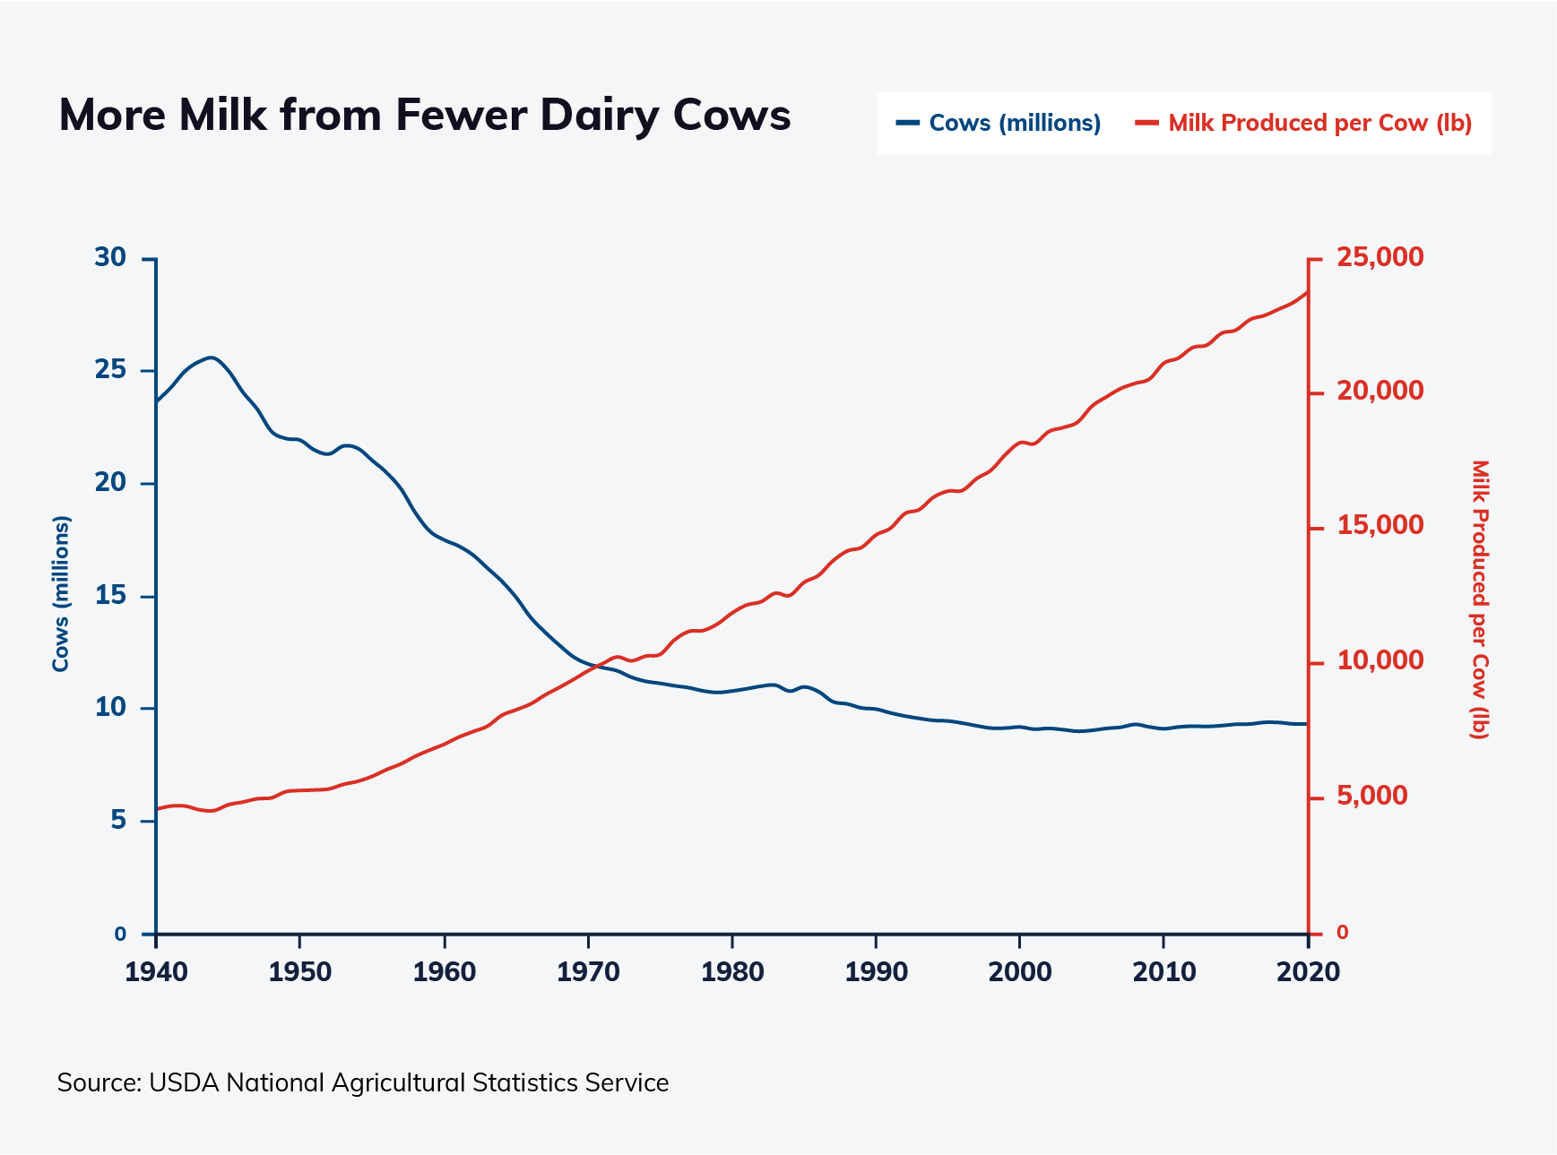
Trends in Production Efficiency Over Time Are Promising 随着时间的推移，生产效率的趋势是有希望的
更少的牛产更多的牛奶
-奶牛（百万）
-单产（磅）
美国在2007-2017年间单头奶牛的奶量提升了4508磅
意味着在2017年每产一加仑牛奶所用的材料少了：
饲料
土地
水
燃料
2017年每加仑牛奶的碳足迹比2007年底19.2%
205 Kgs/Cow/Year for 10 years
10年间205kgs/牛/年

Slide 9
U.S. Holstein Genetic Trend for NM$ 美国荷斯坦牛净收益趋势
奶牛预测遗传潜力
公牛预测遗传潜力
CDCB Apr. 2025

Slide 10
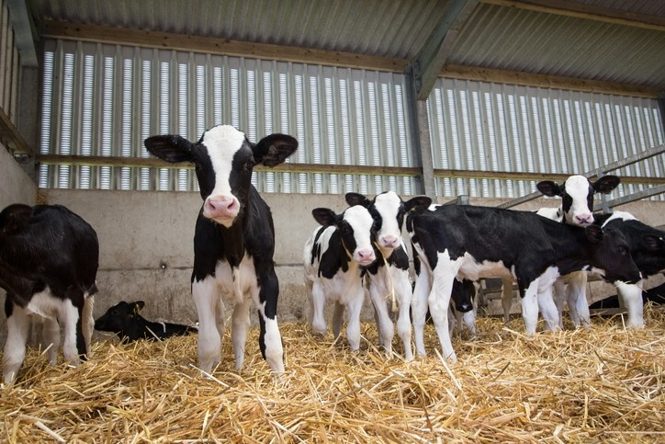
Dairy cattle evaluations were transformed in 2009 when genomic data was added. Genomics uses a young animal’s DNA to estimate their genetic potential which gives dairy farmers confidence to make informed breeding decisions with their youngstock. 2009年，随着基因组数据的引入，奶牛遗传评估发生了革命性转变。基因组技术通过幼畜的DNA来预测其遗传潜力，使奶农能够更有把握地对青年牛群做出科学的选育决策。
The Impact of Genomics基因组学的影响
The Value of Genomic Testing
基因组检测的价值
Genetic Advancement 基因改善
Genetic Merit determined at a young age
在幼龄阶段即可测定基因优势
More reliable prediction of genetic merit than pedigree alone
与系谱分析相比遗传优势预测更可靠
Access to more A.I. sires of higher genetic levels
可选用遗传水平更高的优质人工授精公牛
Identification of genetic conditions
遗传缺陷的鉴定
Expedites development of new traits.
促进新性状的选育进程

Slide 11
Dairy Operations create A LOT of Data
奶牛从业者创造很多数据
This can be very powerful when collected, assembled, analyzed, and applied!
当收集、组装、分析和应用后将非常强大！
Notes:
Cows generate a lot of data – this can be very powerful when collected, assembled, analyzed, and applied! Dairy cows go through a milking parlor two or three times a day or even more if they’re in a barn with robotic milkers, where they could choose a visit many times a day. Milk can be assessed for different components which lead to additional points! If a cow has a 305-day lactation, that’s at least 610 visits to the parlor- and this data just pertains to her milking performance.
An individual Milk Sample tells us:
Fat: Knowing % fat identifies opportunities for greater returns can aid in determining rumen health & function
Protein: Optimizing % protein improves milk’s nutritional content, enhances, cheese & yogurt production
Milk Pregnancy Analysis: Finding open cows sooner improves herd reproductive efficiency, improves production
Milk urea Nitrogen (MUN): Identifying opportunities for greater protein efficiency can improve feeding management.
Somatic Cell Count: Finding high SCC cows helps make better culling decisions, improves overall milk quality and herd production.

Slide 12
Data flow: Farm to Genetic Evaluation
数据流：牧场到基因评估
奶牛育种委员会提供支持
基因评估、个体指标、选择工具、对标、群体描述、数据分析
牧场数据提供方
牛奶
实验室
合作商、奶牛媒体、牧场软件及其他
奶牛育种委员会
动物编号、产量、关系、管理、性能、健康
脂肪、体细胞、蛋白
奶样、动物编号、数据
方法、生物学意义、尖端技术
统一的胎次、关系、性能、管理、健康
美国农业部基因组学与改良实验室
牧场数据分析中心
记录、分类/体型评估
纯种奶牛协会
动物编号、关系及核准
国家合作数据库
组织样品、动物编号
公牛状态代码
国家动物育种协会
动物、样品编号和关系
基因组候选者
组织样品
基因型数据
基因组实验室

Slide 13
Diversify Sire Lines
公牛血统多样性
-为Graze PRO项目精选前50名种公牛无角（强调无角基因）和短毛特性
-优化血统多样性（最大限度减少全同胞公牛使用）
- Utilize top 50 sires for GrazePRO, Polled (emphasize PP), Slick
- Optimize Pedigree Variety (minimize full sibs)
Utilize all tools to minimize all known genetic abnormalities
利用所有工具将已知基因缺陷降到最低
Create opportunities to excel in HHP$
创造机会突出HHP$（健康收益指数）的表现
Global Holstein Selection Guidelines
全球荷斯坦选择指南 (2025 approved)（2025年批准）
Emphasize Z Lame, Z CW$, LIV and proper teat length
突出肢蹄健康、产犊难易度、长寿性和理想乳头长度
Service Sires (in priority order)
种公牛优选方案（按优先级排序）
排名前100的种公牛中选取：SSI$（精选公牛收益指数）、HHP$（健康收益指数）、TPI（综合性能指数）、DWP$（乳成分价值指数）、NM$（净收益指数）；如果数据完整则重点增加：肢体健康、产犊难易度和长寿性等指数
Among top 100 – SSI$, HHP$, TPI, DWP$, NM$
When known, place additional emphasis on Z_Lame, Z_CW$, LIV
Maternal Grand Sires母系祖父牛选育标准
MGS HHP$, TPI, NM$, or other leading domestic or international index greater than average of Active AI sires, Proven and Genomic
所选母系祖父牛的HHP$（健康收益指数）、TPI（综合性能指数）、NM$（净收益指数）或其他国内外主流遗传指数，需超过现役验证公牛（包括后裔测定验证公牛和基因组青年公牛）群体的平均水平
Potential Bull Dams潜在种公牛母系
Among the top HHP$, TPI, NM$, SSI$, and HHP$ Females
从HHP$（健康收益指数）、TPI（综合性能指数）、NM$（净收益指数）、SSI$（抗热应激指数）等遗传指标排名前列的母牛中筛选

Slide 14
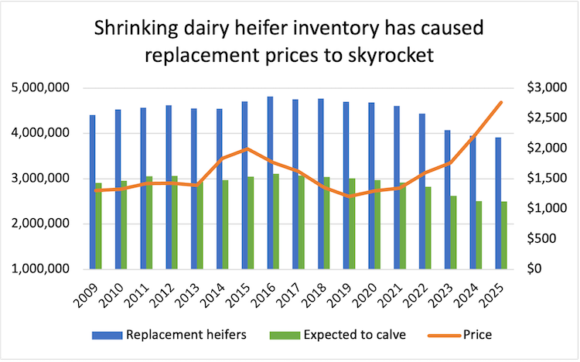
缩减的后备牛存栏量导致替换成本飙升
后备牛
预计产犊的牛
价格
Hoard’s Dairyman

Slide 15
Why are cows leaving the herd? 为什么奶牛在离群？
And why should we care? 我们为什么需要关注？
Fertility 繁殖性能
Improving Pregnancy Rate by 6% reduces total herd methane by 10% and increases profit $49 per cow per year
提高6%的怀孕率可减少10%的牛群甲烷总量，每头牛每年可增加49美元的利润
Mastitis 乳房炎
Cows with clinical mastitis have 6% higher carbon footprint per unit of milk.
患有临床乳房炎的奶牛每单位牛奶的碳足迹高出6%
Milk Production 产奶量
High Production equates to more lifetime profit per cow, improving sustainability with fewer cows.
高产量意味着每头奶牛的终身利润更高，用更少的奶牛提高可持续性。
Lameness 蹄病
Reduce culling, raise fewer replacements and spend less time and money treating cows.
减少淘汰，减少后备牛饲养，减少治疗奶牛的时间和金钱。
Notes:
Cull Rates: How is Your Farm Doing? (psu.edu)

Slide 16
指标
Traits 1 2 3 4 5 6 7 8 9 10 11 12 13 14 15 16 17 18 19 20 21 22 23 24
MILK FAT PROT PL SCS BWC UDC FLC DPR CA$ HCR CCR LIV GL HTH$ RFI MFEV DA KET MAS MET RPL EFC HLV
MILK 1.000 0.399 0.835 0.113 0.179 -0.131 0.042 -0.100 -0.342 0.089 -0.138 -0.219 -0.191 -0.235 -0.032 -0.008 0.027 0.104 0.107 -0.209 0.089 -0.065 0.276 0.194
FAT 0.399 1.000 0.591 0.090 0.080 -0.115 0.056 -0.025 -0.245 0.205 -0.044 -0.123 -0.116 -0.198 0.134 -0.020 0.089 0.194 0.279 -0.106 0.230 0.014 0.178 0.194
PROT 0.835 0.591 1.000 0.128 0.168 -0.100 -0.006 -0.121 -0.307 0.133 -0.153 -0.176 -0.179 -0.267 0.036 -0.005 0.077 0.145 0.277 -0.194 0.166 -0.075 0.329 0.169
PL 0.113 0.090 0.128 1.000 -0.456 -0.221 -0.001 -0.008 0.544 0.363 0.305 0.629 0.728 -0.136 0.661 -0.078 0.119 0.498 0.459 0.496 0.407 0.218 0.270 0.398
SCS 0.179 0.080 0.168 -0.456 1.000 -0.192 -0.021 0.016 -0.313 -0.066 -0.145 -0.299 -0.285 -0.073 -0.550 -0.124 -0.085 -0.164 -0.228 -0.725 -0.193 -0.187 -0.053 -0.182
BWC -0.131 -0.115 -0.100 -0.221 -0.192 1.000 0.098 0.177 -0.024 -0.125 -0.097 -0.085 -0.207 0.081 0.002 0.143 0.080 -0.142 0.016 0.124 -0.030 -0.010 -0.024 0.048
UDC 0.042 0.056 -0.006 -0.001 -0.021 0.098 1.000 0.398 -0.195 -0.008 0.010 -0.138 -0.286 0.029 0.044 -0.018 0.118 0.015 0.143 0.046 0.010 -0.043 -0.175 0.134
FLC -0.100 -0.025 -0.121 -0.008 0.016 0.177 0.398 1.000 -0.141 0.003 0.028 -0.157 -0.107 0.062 -0.010 -0.105 0.054 0.052 0.009 0.035 -0.106 -0.067 -0.142 0.071
DPR -0.342 -0.245 -0.307 0.544 -0.313 -0.024 -0.195 -0.141 1.000 0.264 0.514 0.930 0.485 0.041 0.342 0.088 0.004 0.119 0.154 0.303 0.270 0.221 0.293 0.128
CA$ 0.089 0.205 0.133 0.363 -0.066 -0.125 -0.008 0.003 0.264 1.000 0.176 0.329 0.198 -0.250 0.249 -0.091 0.103 0.196 0.222 0.076 0.284 0.061 0.211 0.264
HCR -0.138 -0.044 -0.153 0.305 -0.145 -0.097 0.010 0.028 0.514 0.176 1.000 0.599 0.187 0.163 0.194 0.016 -0.035 0.120 0.088 0.163 0.117 0.122 0.328 0.165
CCR -0.219 -0.123 -0.176 0.629 -0.299 -0.085 -0.138 -0.157 0.930 0.329 0.599 1.000 0.488 -0.008 0.411 0.041 0.030 0.202 0.224 0.313 0.334 0.237 0.299 0.223
LIV -0.191 -0.116 -0.179 0.728 -0.285 -0.207 -0.286 -0.107 0.485 0.198 0.187 0.488 1.000 -0.049 0.494 -0.069 0.036 0.429 0.226 0.384 0.253 0.200 0.137 0.202
GL -0.235 -0.198 -0.267 -0.136 -0.073 0.081 0.029 0.062 0.041 -0.250 0.163 -0.008 -0.049 1.000 -0.121 0.026 -0.083 -0.153 -0.196 0.016 -0.158 0.066 -0.265 -0.140
HTH$ -0.032 0.134 0.036 0.661 -0.550 0.002 0.044 -0.010 0.342 0.249 0.194 0.411 0.494 -0.121 1.000 0.032 0.243 0.690 0.625 0.676 0.731 0.497 0.147 0.300
RFI -0.008 -0.020 -0.005 -0.078 -0.124 0.143 -0.018 -0.105 0.088 -0.091 0.016 0.041 -0.069 0.026 0.032 1.000 0.052 -0.094 0.000 0.070 0.056 0.073 0.008 -0.046
MFEV 0.027 0.089 0.077 0.119 -0.085 0.080 0.118 0.054 0.004 0.103 -0.035 0.030 0.036 -0.083 0.243 0.052 1.000 0.239 0.294 0.044 0.212 0.061 -0.061 -0.053
DA 0.104 0.194 0.145 0.498 -0.164 -0.142 0.015 0.052 0.119 0.196 0.120 0.202 0.429 -0.153 0.690 -0.094 0.239 1.000 0.587 0.200 0.396 0.137 0.157 0.179
KET 0.107 0.279 0.277 0.459 -0.228 0.016 0.143 0.009 0.154 0.222 0.088 0.224 0.226 -0.196 0.625 0.000 0.294 0.587 1.000 0.187 0.515 0.179 0.130 0.200
MAS -0.209 -0.106 -0.194 0.496 -0.725 0.124 0.046 0.035 0.303 0.076 0.163 0.313 0.384 0.016 0.676 0.070 0.044 0.200 0.187 1.000 0.148 0.135 0.077 0.287
MET 0.089 0.230 0.166 0.407 -0.193 -0.030 0.010 -0.106 0.270 0.284 0.117 0.334 0.253 -0.158 0.731 0.056 0.212 0.396 0.515 0.148 1.000 0.637 0.124 0.166
RPL -0.065 0.014 -0.075 0.218 -0.187 -0.010 -0.043 -0.067 0.221 0.061 0.122 0.237 0.200 0.066 0.497 0.073 0.061 0.137 0.179 0.135 0.637 1.000 -0.067 0.064
EFC 0.276 0.178 0.329 0.270 -0.053 -0.024 -0.175 -0.142 0.293 0.211 0.328 0.299 0.137 -0.265 0.147 0.008 -0.061 0.157 0.130 0.077 0.124 -0.067 1.000 0.329
HLV 0.194 0.194 0.169 0.398 -0.182 0.048 0.134 0.071 0.128 0.264 0.165 0.223 0.202 -0.140 0.300 -0.046 -0.053 0.179 0.200 0.287 0.166 0.064 0.329 1.000
奶量
乳脂
蛋白
生产寿命
体细胞
体重综合
乳房综合
肢蹄综合
女儿怀孕率
产犊能力价值
青年牛受胎率
母牛体型评分
寿命
放牧寿命
健康活力价值
剩余采食量
乳脂经济价值
变胃
酸中毒
乳房炎
子宫炎
相对生产水平
初产提前天数
青年牛存活率
Genetic Correlations
基因相关性

Slide 17
Correlated traits and heritability…..critical to know in sire selection 相关性状和遗传力.....了解这一点在选种中很重要
 | Milk | Fat | Protein | PL | SCS | DPR | CCR | UDC
Milk | 0.20 | 0.60 | 0.86 | 0.46 | -0.21 | -0.36 | -0.17 | 0.46
Fat |  | 0.20 | 0.81 | 0.57 | -0.09 | -0.38 | -0.06 | 0.55
Protein |  |  | 0.20 | 0.13 | 0.04 | -0.18 | -0.08 | 0.56
PL |  |  |  | 0.08 | -0.67 | 0.32 | 0.48 | 0.56
SCS |  |  |  |  | 0.12 | -0.19 | -0.27 | -0.42
DPR |  |  |  |  |  | 0.04 | 0.91 | -0.17
CCR |  |  |  |  |  |  | 0.02 | -0.04
UDC |  |  |  |  |  |  |  | 0.27
产奶量
乳脂
乳蛋白
生产寿命
体细胞评分
面临的挑战：如何在遗传能力和不利的遗传相关性存在差异的情况下，在所有性状上取得遗传进展
女儿怀孕率
母牛体型评分
乳房综合指数
The challenge: how to make genetic progress for all traits, despite differences in heritabilities and unfavorable genetic correlations

Slide 18
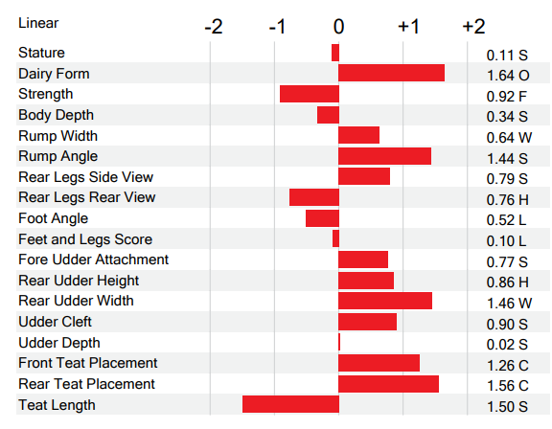
Keep Linear Charts in Perspective
正确理解线性评分表的定为
 | Average mature daughter measurement corresponding to linear Type STA
 | 线性体型评分对应的成年女儿平均表型值
 |  | STA of Sire
 | Unit | -3 | 0 | 3 | Heritability
Stature | Inches/cm | 58.9/150 | 60.2/153 | 61.5/156 | .45
Rump Angle | Inches/cm | 0.3/0.8 | 1.0/2.5 | 1.7/4.3 | .34
Rump Width | Inches/cm | 6.0/15.2 | 6.4/16.3 | 6.8/17.3 | .25
Foot Angle | Degrees | 43 | 45 | 47 | .11
Rear Udder Height | Inches/cm | 9.9/25 | 9.4/24 | 9.0/23 | .21
Rear Udder Width | Inches/cm | 6.0/15 | 6.4/16 | 6.7/17 | .17
Udder Cleft | Inches/cm | 1.2/3.0 | 1.3/3.3 | 1.4/3.6 | .18
Udder Depth | Inches/cm | 1.1/2.8 | 1.9/4.8 | 2.8/7.1 | .33
Rear Teat Placement | Inches/cm | 1.8/4.6 | 1.4/3.6 | 1.1/2.8 | .27
Teat Length | Inches/cm | 2.0/5.1 | 2.1/5.3 | 2.3/5.8 | .25
单位
公牛标准化体型评估
遗传性
身高
尻角度
尻宽
蹄角度
后乳房高度
后乳房宽度
乳房悬韧带
乳房深度
后乳头位置
乳头长度
Holstein Association USA

Slide 19
Trends in Production Efficiency Over Time Are Promising 随着时间的推移，生产效率的 趋势是有希望的
更少的奶牛产更多的牛奶
-奶牛（百万）
-单产（磅）
美国在2007-2017年间单头奶牛的奶量提升了4508磅
意味着在2017年每产一加仑牛奶所用的材料少了：
饲料
土地
水
燃料
2017年每加仑牛奶的碳足迹比2007年底19.2%
205 Kgs/Cow/Year for 10 years
10年间205kgs/牛/年

Slide 20
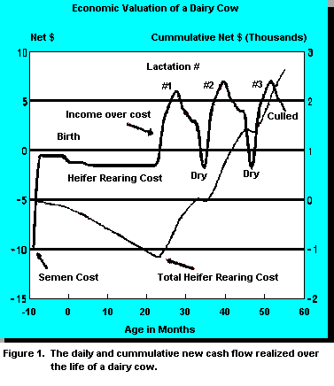
Economic Valuation of a Dairy Cow
Pregnancy Rate 怀孕率
Calf Health Events 犊牛健康事件
Age at calving 产犊月龄
Production 产量
Cow Health Events 奶牛健康事件
Production 产量
Calving Interval 产犊间隔
Repeat….Repeat….Repeat
重复….重复….重复
奶牛的经济价值评估
净收益$
累计净收益$(千)
胎次
净收益
后备牛饲养成本
冻精成本
后备牛总成本
月龄
一头奶牛在其整个生命周期内所实现的每日及累计新增现金流总额
Ferguson and Galligan, WCDS, 1995.
Notes:
Elise wasn’t alone in her destiny, and she’s one of many animals who never recover the cost of raising them, due to health challenges.
As we circle back to today… many economic estimates will point to the fact that most animals will not pay for the cost of raising them until sometime in their second lactation, as shown in this graph. So it’s the heifers that make it into their third or greater lactation that especially end up paying for those heifers that don’t.
ALTERNATE (Short) – So le’ts reflect on what the industry will look like

Slide 21
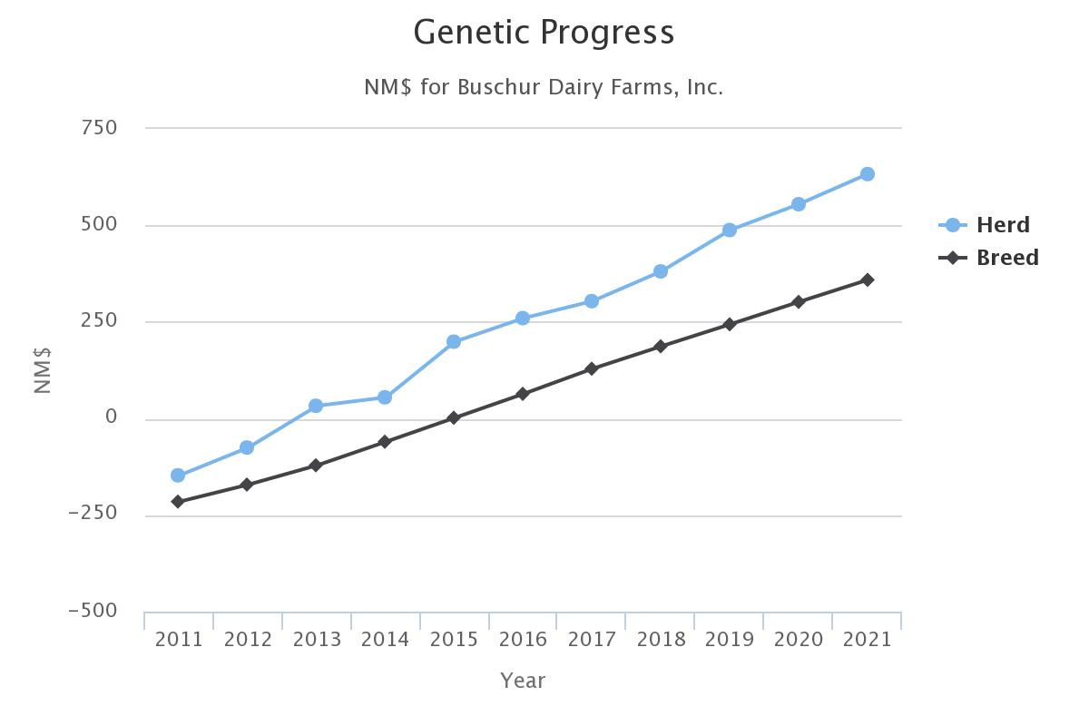
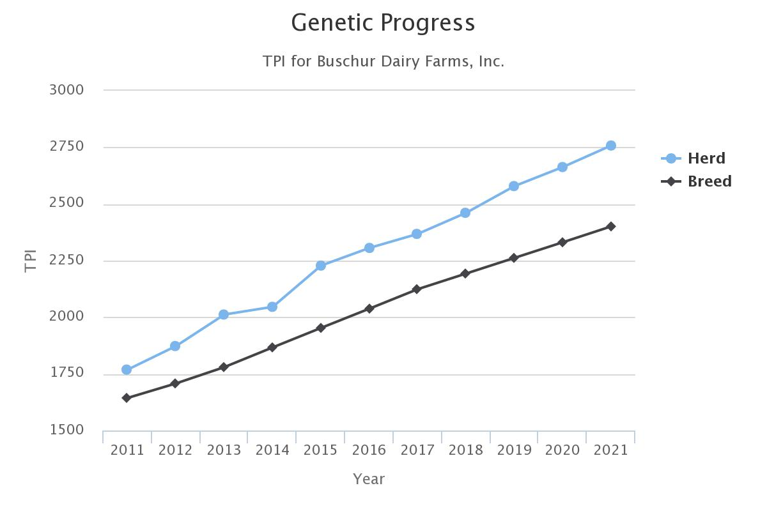
遗传进展
--牛群
--品种
净价值指数
遗传进展
--牛群
--品种
综合性能指数
年份
What Happens when
maximizing Genetic inputs
Begin!
开始最大化遗传输入后所发生的情况！
年份

Slide 22
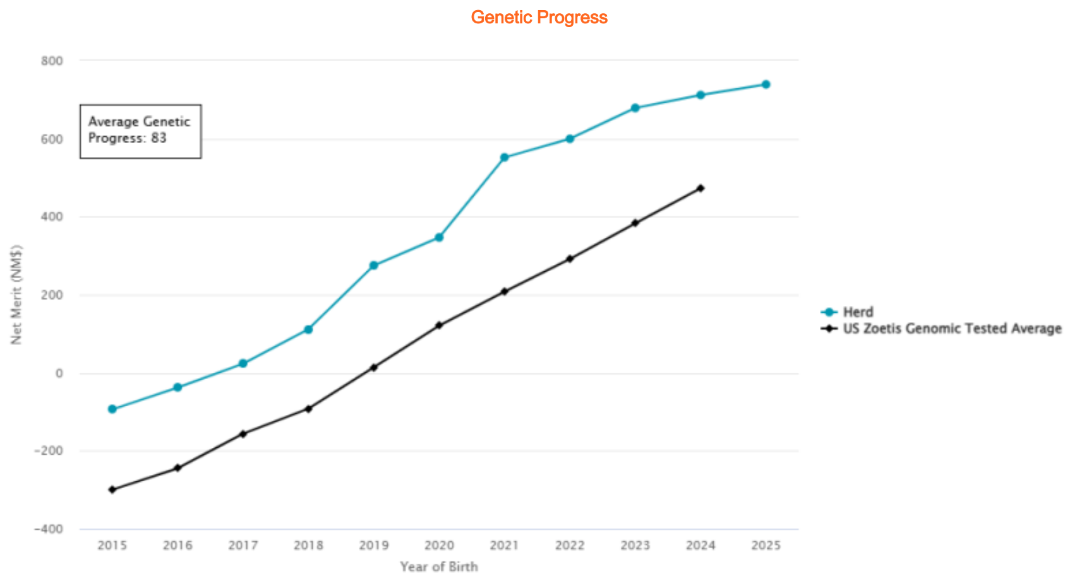
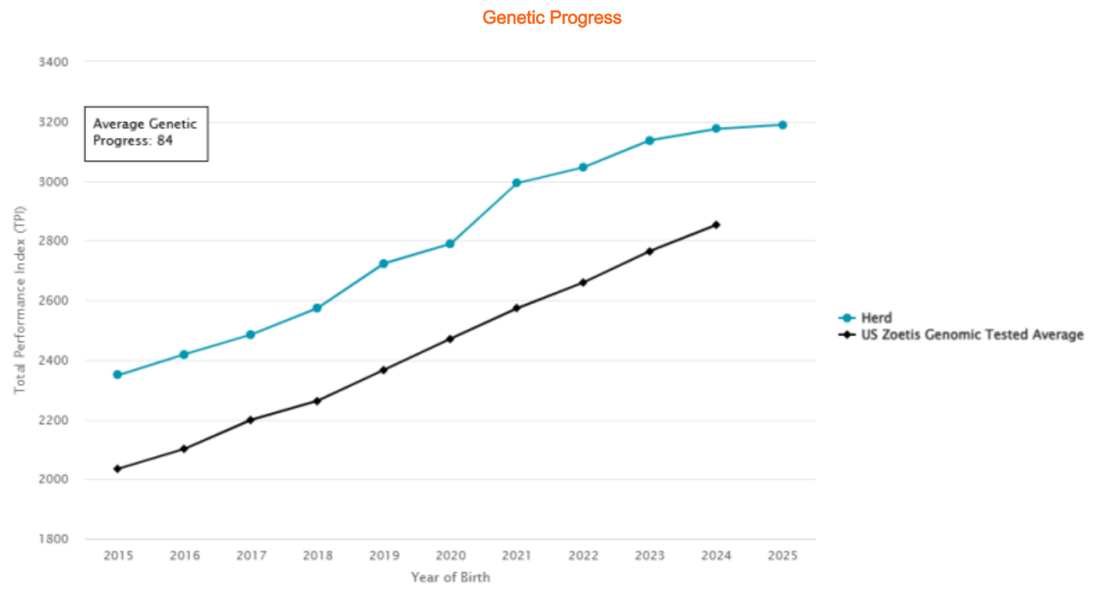
遗传进展
平均遗传进展：83
净价值指数
遗传进展
--牛群
--美国硕腾基因组检测平均
平均遗传进展：84
综合性能指数
出生年份
What Happens when
maximizing Genetic inputs
are sacrificed!
当牺牲最大化遗传输入后发生的情况！
--牛群
--美国硕腾基因组检测平均
出生年份

Slide 23
Why are cows leaving the herd? 为什么奶牛在离群？
And why should we care? 我们为什么需要关注？
Fertility 繁殖性能
Improving Pregnancy Rate by 6% reduces total herd methane by 10% and increases profit $49 per cow per year
提高6%的怀孕率可减少10%的牛群甲烷总量，每头牛每年可增加49美元的利润
Mastitis 乳房炎
Cows with clinical mastitis have 6% higher carbon footprint per unit of milk.
患有临床乳房炎的奶牛每单位牛奶的碳足迹高出6%
Milk Production 产奶量
High Production equates to more lifetime profit per cow, improving sustainability with fewer cows.
高产量意味着每头奶牛的终身利润更高，用更少的奶牛提高可持续性。
Lameness 蹄病
Reduce culling, raise fewer replacements and spend less time and money treating cows.
减少淘汰，减少后备牛饲养，减少治疗奶牛的时间和金钱。
Notes:
Cull Rates: How is Your Farm Doing? (psu.edu)

Slide 24
Utilize the PROPER index for YOUR herd goals
为你的牛群目标使用合适的指标
Relative Weights 相对权重
综合性能指数 净收益指数 产犊难易度指数 乳成分价值指数 健康收益指数
 | TPI® | NM$ | CM$ | DWP$® | HHP$®
Milk | 0% | 3% | -3% | 1% | 0%
CFP | 44% | 45% | 47% | 34% | 49%
Mastitis, SCS | 5% | 3% | 3% | 13% | 13%
Fertility | 13% | 5% | 5% | 12% | 12%
Other Cow Health | 9% | 20% | 19% | 22% | 9%
Calving Ability | 2% | 3% | 3% | 1% | 0%
Calf Health | 0% | 1% | 1% | 5% | 0%
Conformation | 25% | 2% | 2% | 0% | 12%
Size/RFI | -2% | -18% | -17% | -11% | -5%
奶产量
碳足迹
乳房炎、体细胞
繁殖性能
其他奶牛健康
产犊能力
犊牛健康
构造
体型/饲料效率
®TPI is a registered trademark of Holstein Association USA.
®Herd Health Profit Dollars and HHP$ are trademarks of Select Sires Inc.
®DWP$ is a registered trademark of Zoetis Services LLC.

Slide 25
Utilize Programs that have built in diversity…
Not singular focus on Few Bulls
利用已经建立了多样性的程序… 不要只关注少数公牛
Top 0.5% of female population – 10,000 females
母牛前0.5%的群体—10000头母牛
Top 1% of male population – 75 mating sires
公牛前1%的群体—75头种公牛
Create matings for 7500 genomic tested bulls calves
为7500头经过基因组检测的公犊牛进行配对
Select 500 Bulls to health test – 15:1 selection pressure
选择500头公牛进行健康测试— 15:1选择压力
Sample 300 bulls calves annually – 25:1 selection pressure
每年取样300头公犊牛— 25:1选择压
Select Pressure is our job!
Herd breeding goals are your job!
选择压是我们的工作！
你们负责牛群繁殖工作！

Slide 26
Selection Process:选择流程
1
2
3
Herd Health Profit Dollars
健康收益指数
Dairy Wellness Profit Dollars
奶牛收益指数
Select Sires Dollars
精选公牛收益指数
Net Merit Dollars
净收益指数
Cheese Merit Dollars
奶酪价值指数
Breed Index (TPI and JPI)
综合育种指数（综合性能和娟姗专用性能）
International Indices
国际通用指数
Combined Fat & Protein
乳成分综合指数
Fertility Traits
繁殖性能性状
Mastitis Traits
乳房炎抗性性状
Productive Life
生产寿命
Udder Composite
乳房结构综合指数
Milk Proteins
乳蛋白
Residual Feed Intake
饲料效率性状
Haplotypes
单倍型分析
Pedigree
系谱
Linears
线性评分
Zoetis Lameness
硕腾肢蹄健康评估
Zoetis Calf Wellness
硕腾犊牛健康评估
Marketability
市场适应性
Overall Need
综合需求指数

Slide 27
Genetics is an Investment
基因是一种投资
Genetics is Additive
基因是可加性的
Genetics creates opportunity for Maximizing Herd Management
基因学为最大限度地管理牛群创造了机会
Genetics is the Base Line for Success
基因学是成功的底线
Genetics mandates long term planning
基因学需要长期规划
In Summary….
Don’t miss your opportunity!
不要错失机会！

